Slide 1
COMMITTEE HELPER
MSD PROJECT- TEAM 09
BANSAL SHAH
MUAAZ SALAGAR
MEGHNA TULASI
NEETHU PRASAD

Slide 2
GOAL
An application that assists program committee chairs and associate editors with identifying suitable candidates for their committees.

Slide 3
FUNCTIONALITY
Identify the names of authors who published more than one paper in OOPSLA since the year 2010.
Identify the names of authors who published at least one paper with the words “pointer” and “analysis” in the title.
Identify the names of authors who published at least two papers in OOPSLA or ECOOP and did not serve on the committee during the last two years.
Identify authors who have “similar” profiles to a given author.

Slide 4

WHY IS IT CHALLENGING?
How many papers published?
Any Publication last 3 years?
Did he serve on the committee before?
Are there any similar profiles matching this criteria ?
Data is volatile
More than 2 million records

Slide 5
INTRODUCING
Committee Helper v 1.0

Slide 6
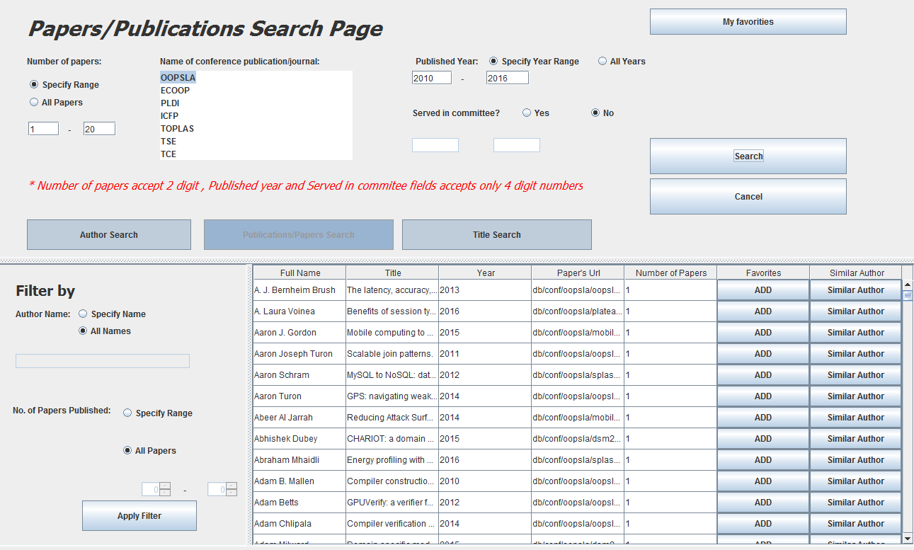
Identify the names of authors who published more than one paper in OOPSLA since the year 2010.

Slide 7
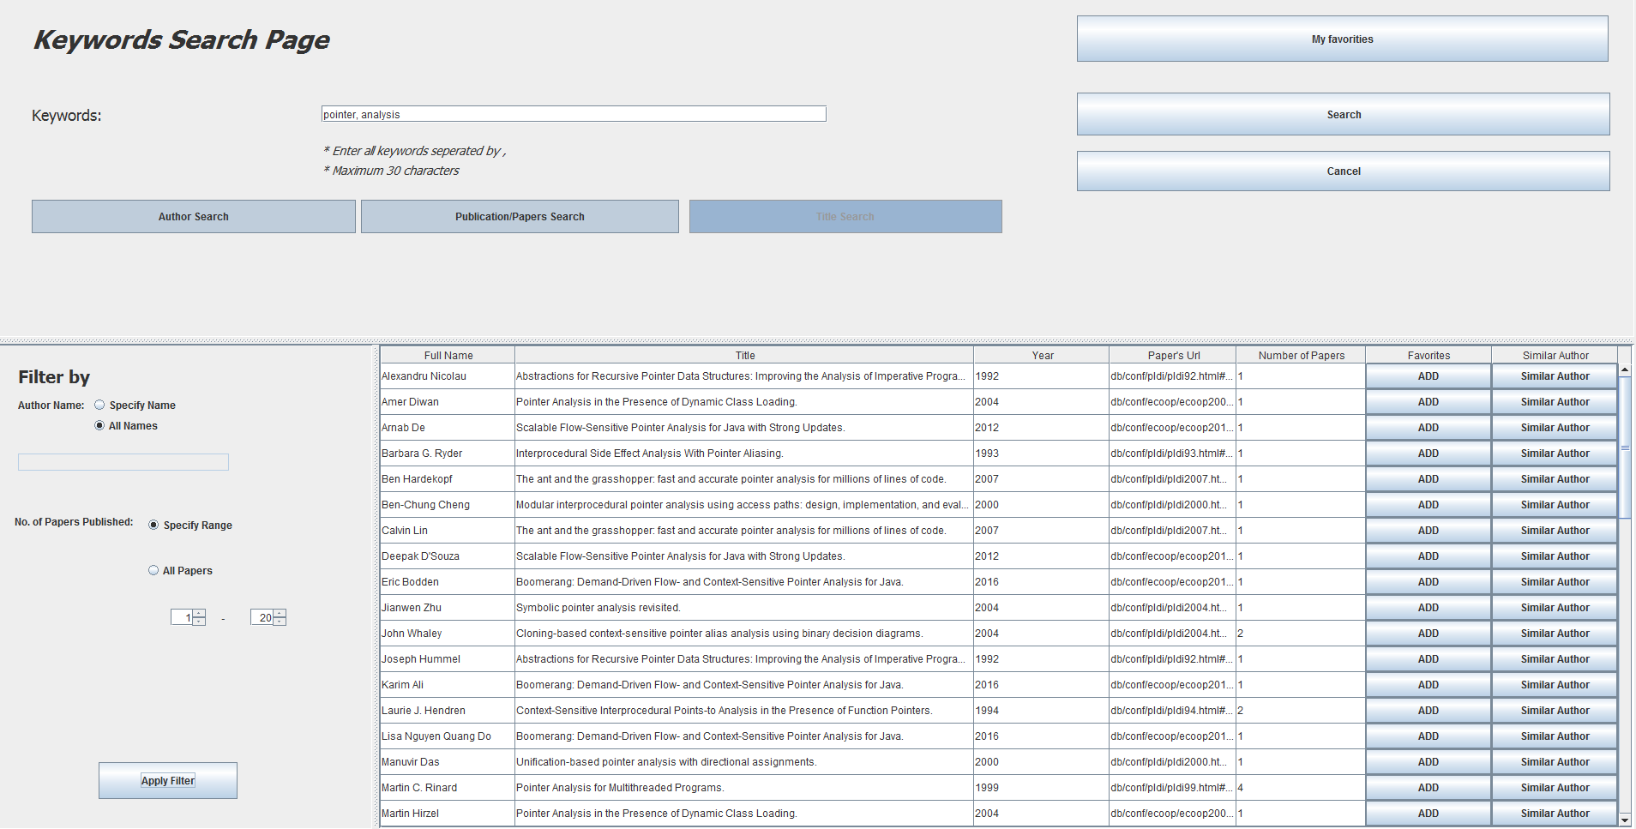
Identify the names of authors who published at papers with the words “pointer” and “analysis” in the title

Slide 8
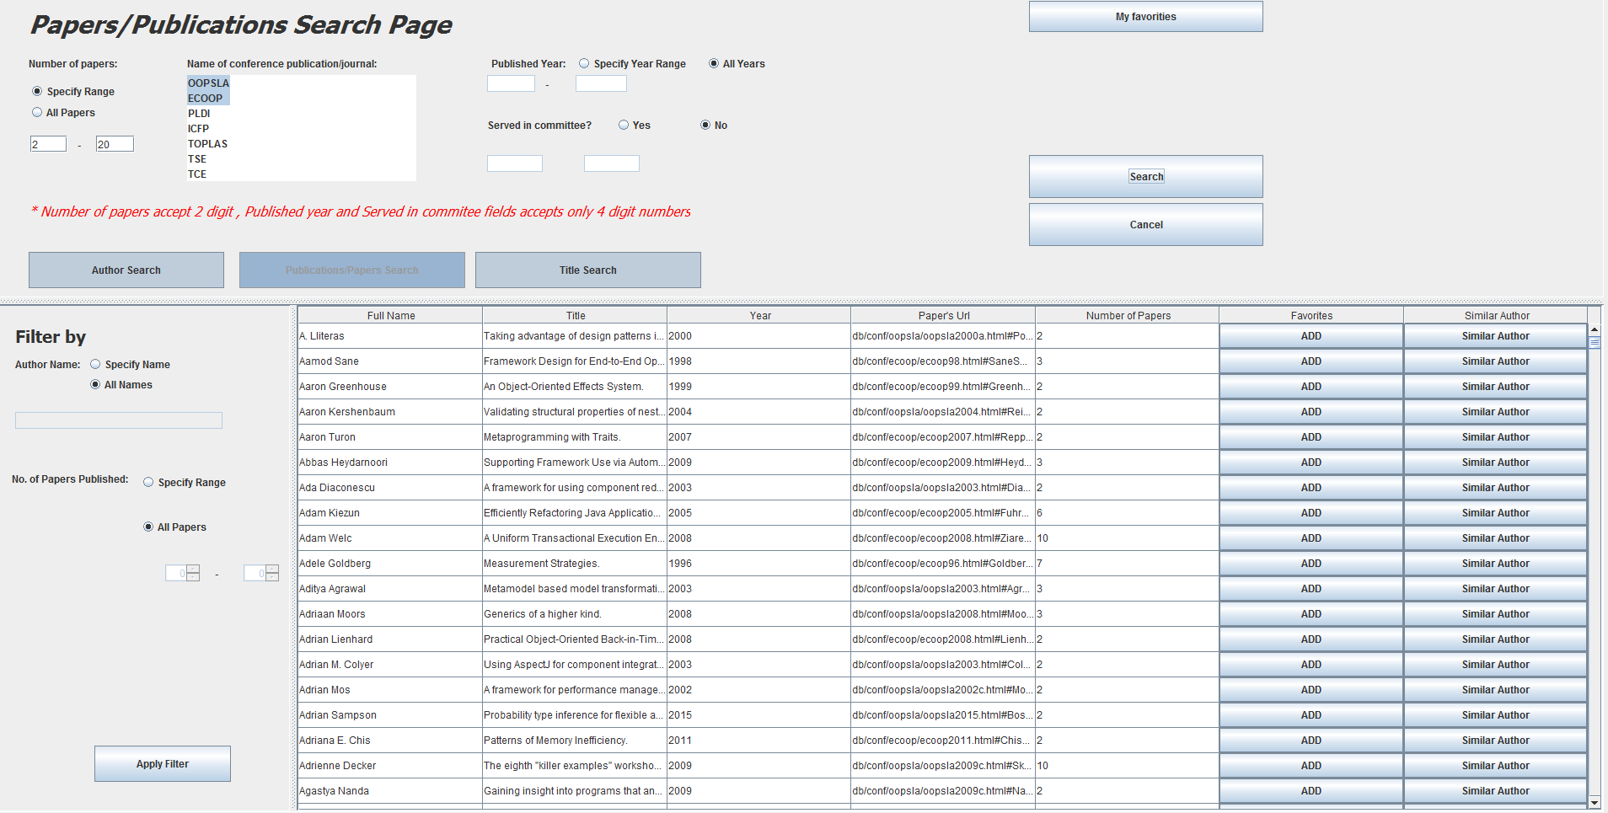
Identify the names of authors who published at least two papers in OOPSLA or ECOOP and did not serve on the committee during the last two years.

Slide 9
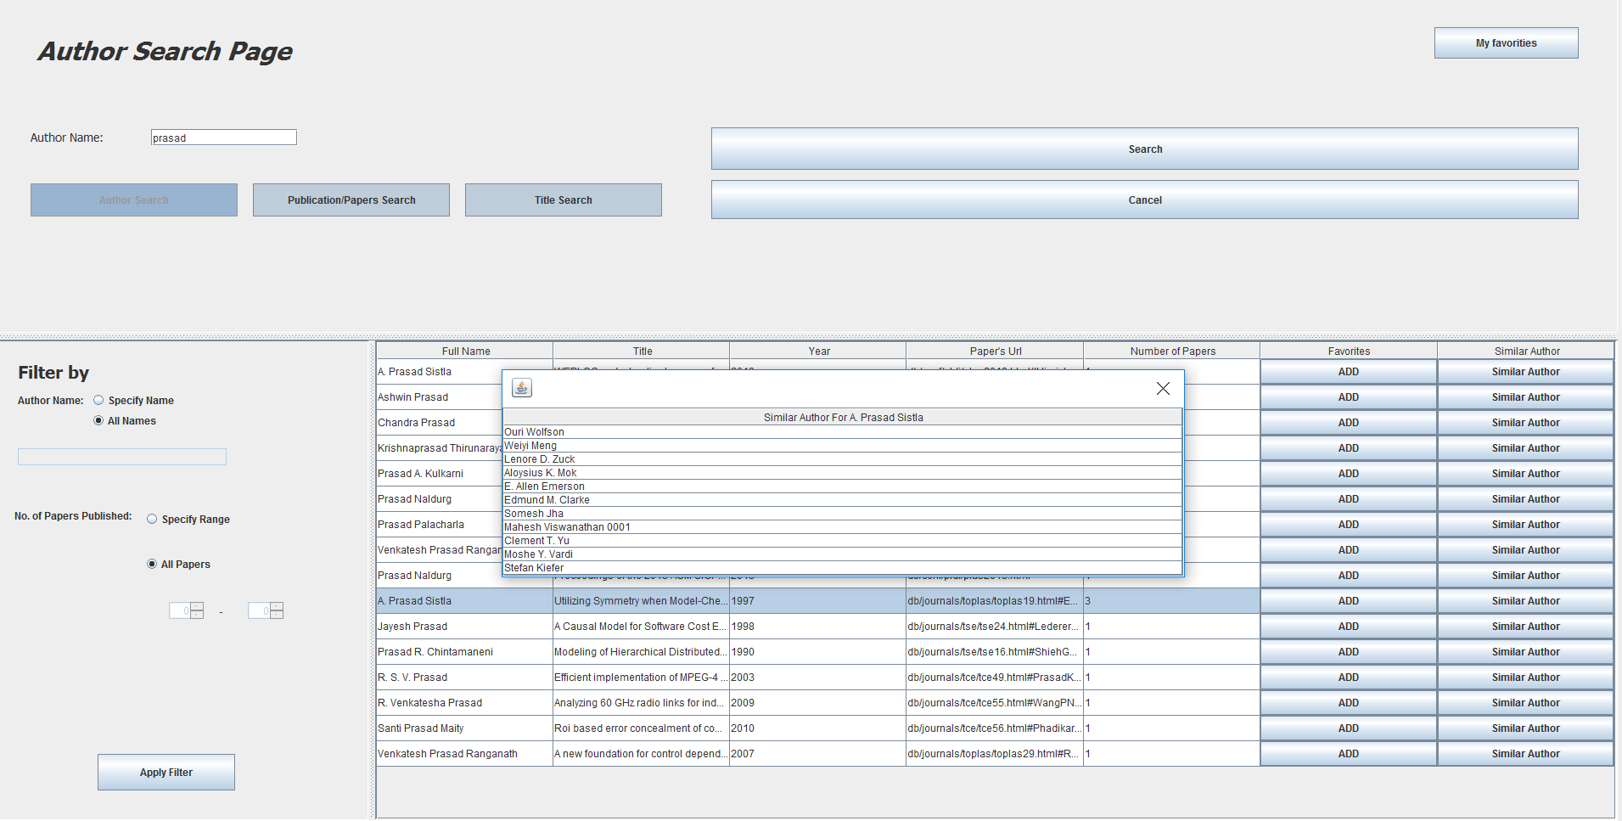
Identify authors who have “similar” profiles to a given author.

Slide 10
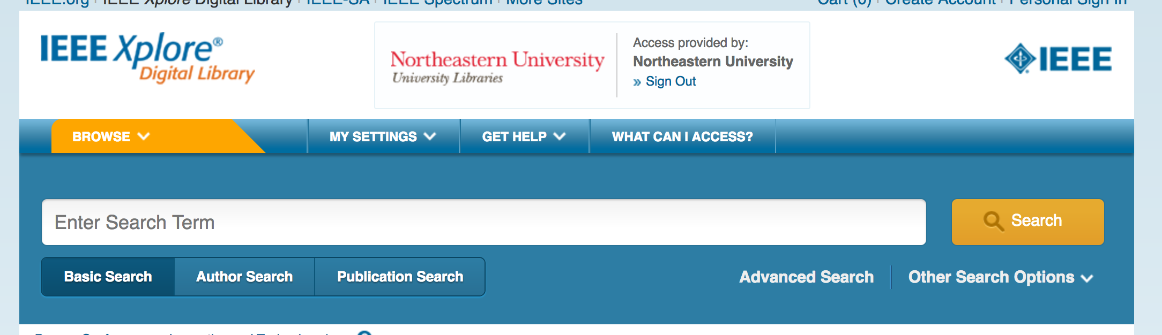
USER EXPERIENCE
Single window search application
Focused on having search, filter, and sort results on a same window

Slide 11
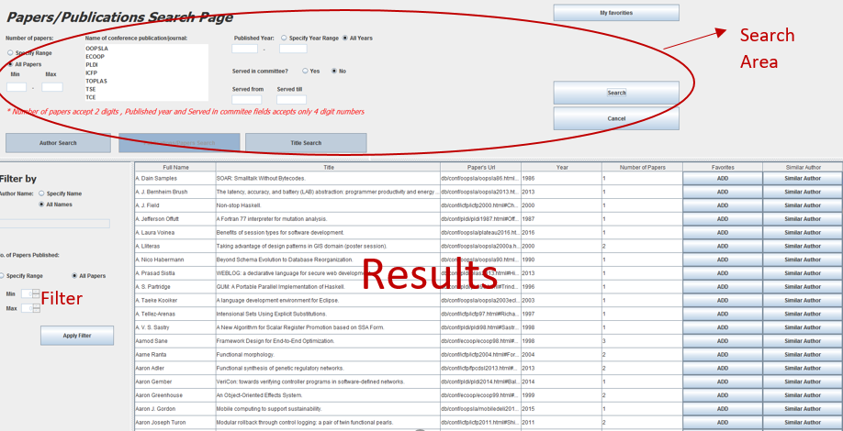
USER EXPEREINCE

Slide 12
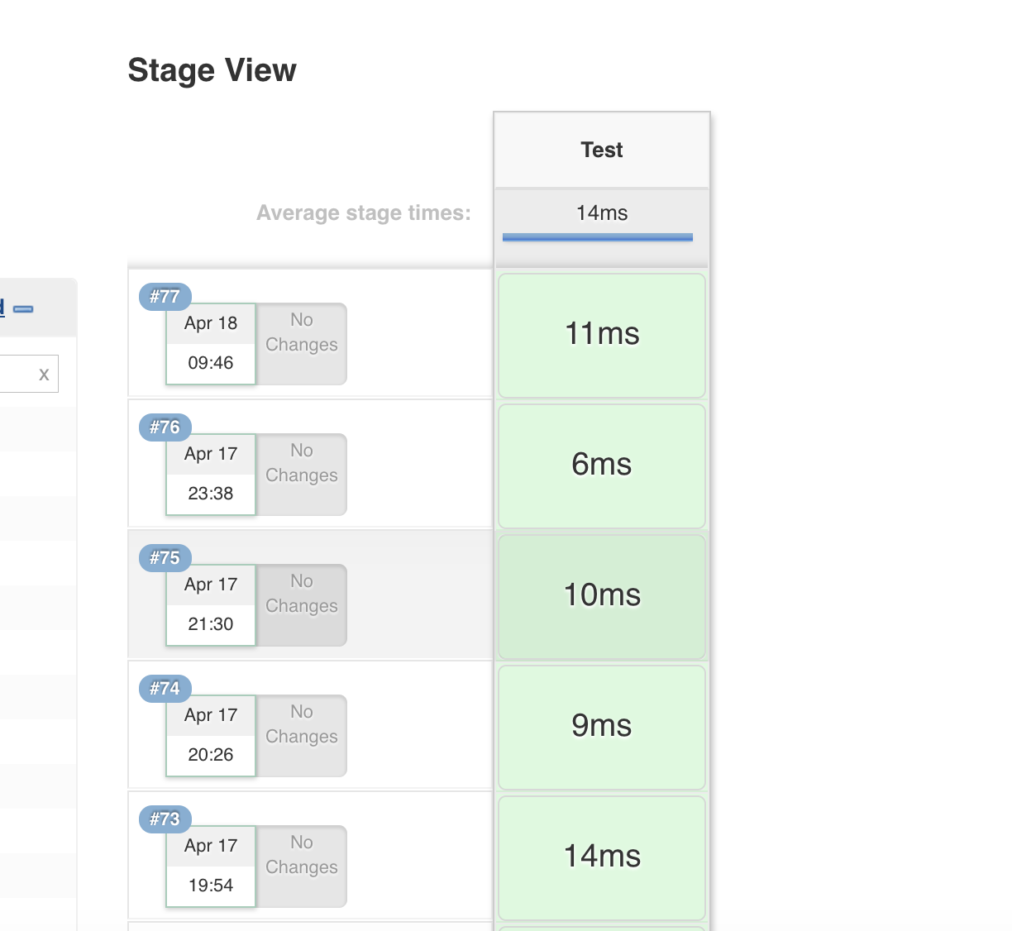
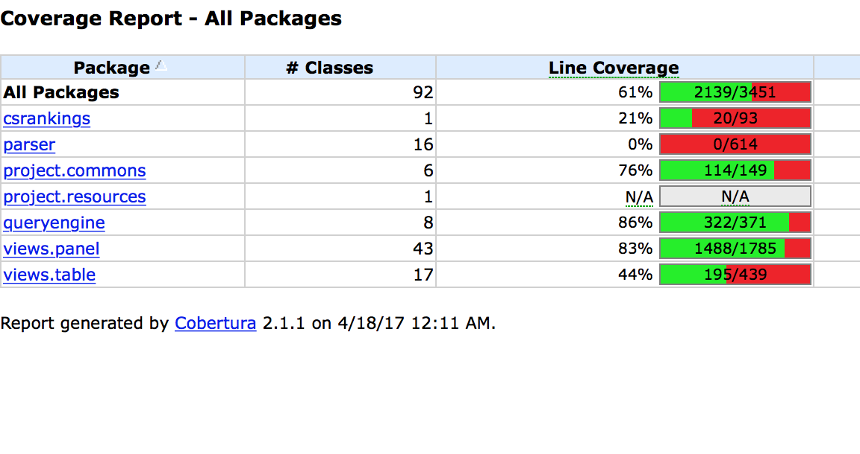
Developed with Test Driven Development
Unit, Integration, System & Regression Testing
--Manual and JUNIT testing and continuous integration with Jenkins

Slide 13
MAINTAINABLE CODE
Future enhancements
Ready to use
-Parser for xml files and data on cloud(RDS support)
Design Patterns (Singleton and Abstract Factory)
DRY (Do not repeat yourself)

Slide 14
PRACTICED CODE REVIEW PROCESS
TASK/BUG /STORY ASSIGNED
ASSIGNED TEAM OPENS ISSUE
CODE IN DEVELOPMENT
ASSIGNED FOR REVIEW BY DIFFERENT SUB-TEAM
ISSUE CLOSED
GIT PUSH

Slide 15
Product Enhancement and Evaluation
New Data source CS Rankings added with latest feature “Similar Author”
Faster response: Result response time improved by 62% (1.2 second for author search with multiple search criteria)
Testing by fellow classmates
-17 Bugs reported including enhancements and questions
Delivered according to updated requirements

Slide 16
DEMO

